Slide 1
Lab4: Implementing BFS, DFS, Greedy and A*
Maleeha Khalid Khan

Slide 2
Content
Create data Frame using pandas
Implement BFS, DFS, Greedy & A* algorithm

Slide 3
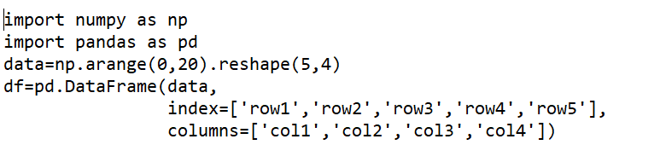
Create Data Frame in python task 1:
Here is simple code of how you are going to create data structure in python
See 0-9 range contains 20 elements and is a 3x3 matrix

Slide 4

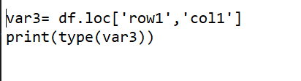
Apply following functions here: check output continue with previous code
When we have 1 row and 1 column then we call it series and when we have more than 1 row and column then we call it data Frame

Slide 5
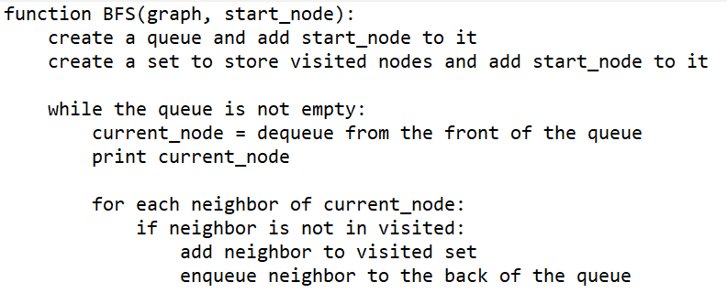
Pseudo code BFS:

Slide 6
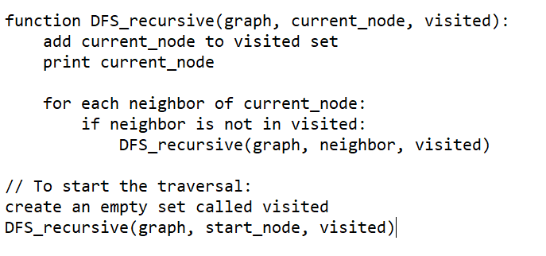
Pseudo Code for DFS

Slide 7
Task:
Implement in any way BFS and DFS and write comments with the code

Slide 8
Task:
After implementing BFS and DFS give the following graph and start node and goal node and solve the following compare results of BFS and DFS
graph = { 'Karachi': ['Lahore', 'Faisalabad'], 'Peshawar': ['Islamabad', 'Quetta'], 'Quetta': ['Peshawar'], 'Multan': ['Lahore', 'Faisalabad'], 'Faisalabad': ['Karachi', 'Multan'], 'Lahore': ['Islamabad', 'Karachi', 'Multan'], 'Islamabad': ['Lahore', 'Peshawar'] }
Karachi is start and Islamabad is goal
Taske help from https://visualgo.net/en/dfsbfs but you have to implement code in python

Slide 9
For Pandas: Task
Import a dataset on pycharm and access first five rows using
Import pandas as pf then use alias pd as pd.head and then use pd.tail and use further pandas function and check outputs

Slide 10
Important
All task should be uploaded on portal before 1pm

